Slide 1



PREDICTIVE ANALYTICS FOR DIABETES PREVENTION

Slide 2



PROBLEM STATEMENT
Diabetes is a chronic condition characterized by high blood sugar levels, which can lead to serious complications such as heart disease, stroke, and kidney failure if not managed effectively.
Early detection and intervention are crucial for improving outcomes and reducing the burden of the disease.
Machine learning techniques offer promising results for predicting diabetes risk based on various health and demographic factors.

Slide 3

OBJECTIVE
The objective is to develop binary classification models that can accurately distinguish between individuals with and without diabetes based on the provided features.
These models should generalize well to unseen data and exhibit high sensitivity and specificity in detecting diabetes cases.

Slide 4

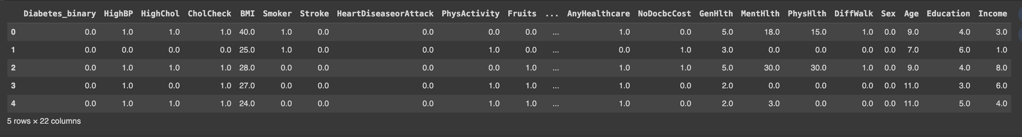

DATASET
The dataset is collected from the Behavioral Risk Factor Surveillance System (BRFSS) 2015 survey.
The dataset contains 253,680 entries and 22 columns, providing a substantial sample size for analysis.
The dataset includes a binary indicator for diabetes status, allowing for binary classification tasks.

Slide 5

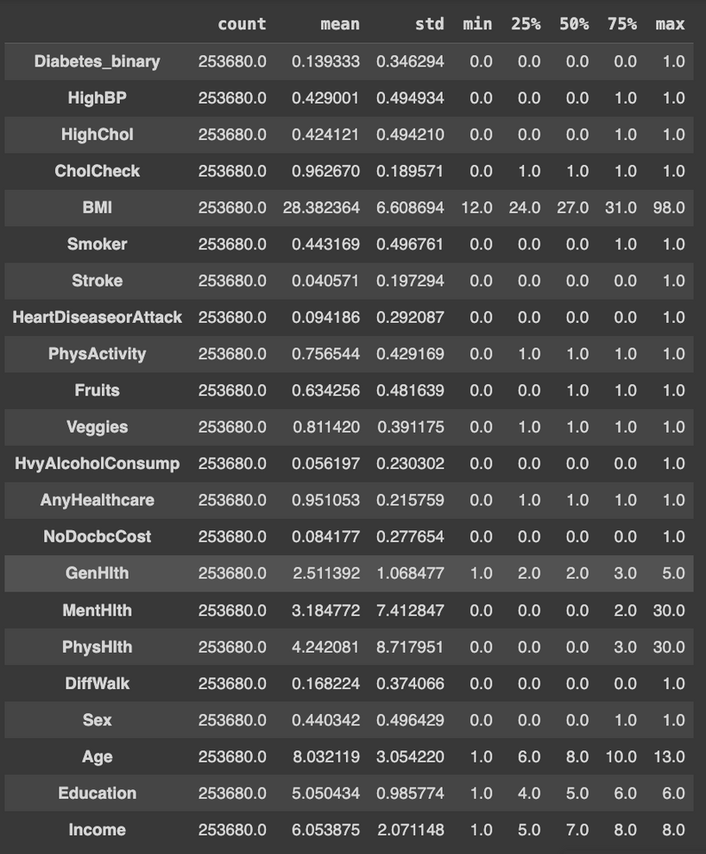

EXPLORATORY DATA ANALYSIS (EDA):
Statastical Analysis
Diabetes_binary: This is our target variable with about 13.9% of the cases having diabetes.
Key statistics suggest a broad range of demographic and health-related attributes, with fields ranging from
binary indicators (e.g., smoker: yes/no) to continuous measures (e.g., BMI, age).
HighBP, HighChol, Smoker, Stroke, HeartDiseaseorAttack, PhysActivity, Fruits, Veggies, HvyAlcoholConsump, AnyHealthcare, NoDocbcCost,DiffWalk,
Sex: These are binary features, representing presence or absence of a condition or behavior.
BMI, GenHlth, MentHlth, PhysHlth: Continuous variables with a range of values that might need normalization or scaling during preprocessing.
Age, Education, Income: Ordinal variables with a defined order but inconsistent intervals.

Slide 6
EDA : DATA PREPROCESSING
No missing values are found
Identify outliers using the Interquartile Range (IQR) method for key numerical columns
Applied a logarithmic transformation to reduce skewness in the data
Dropped Duplicate rows
Converted potential categorical features to 'category' data type.
Normalized the numerical features using Min-Max Scalar

Slide 7
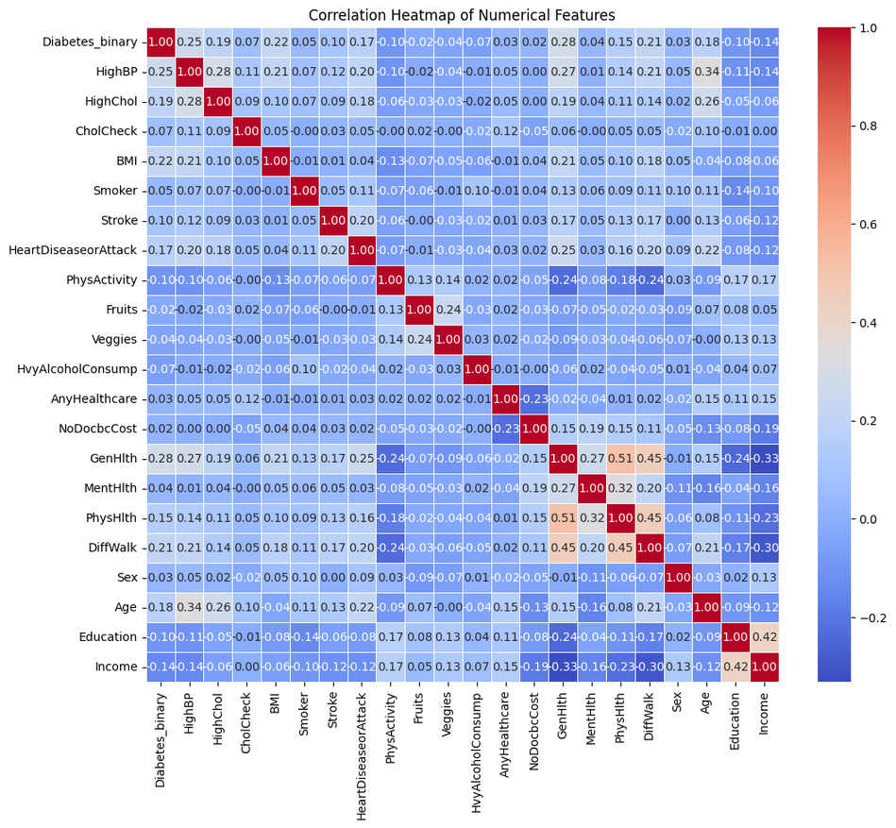
EDA : DATA PREPROCESSING
The correlation heatmap visualizes the relationships between features:
High Correlations: The strongest positive correlations appear between 'HighBP' and 'HighChol', 'HighBP' and 'HeartDiseaseorAttack', 'GenHlth' and 'PhysHlth', and 'GenHlth' and 'DiffWalk', indicating that people with high blood pressure are likely to have high cholesterol and heart diseases, and those who rate their general health poorly often report more physical health problems and difficulty walking.
Diabetes (Diabetes_binary): This variable has moderate positive correlations with 'HighBP', 'HighChol', 'BMI', and 'Age', suggesting that older individuals with higher BMI, blood pressure, and cholesterol levels have a higher prevalence of diabetes.
Notes:
Socio-economic Factors: 'Education' and 'Income' show positive correlations with 'PhysActivity' and negative correlations with 'Diabetes_binary', 'HighBP', 'BMI', 'GenHlth', suggesting that higher socioeconomic status is linked to better health and lifestyle choices.
Lifestyle Factors: 'Smoker' and 'HvyAlcoholConsump' have weaker correlations with health outcomes compared to other factors, which might indicate a more complex relationship or the presence of confounding variables not accounted for in the dataset.

Slide 8
EDA : DATA PREPROCESSING
Negative Correlations with Physical Activity (PhysActivity): There are notable negative correlations between 'PhysActivity' and 'Diabetes_binary', 'HighBP', 'HighChol', 'BMI', and 'GenHlth', indicating that higher physical activity is associated with better health outcomes and lower diabetes prevalence.
Socio-economic Factors: 'Education' and 'Income' show positive correlations with 'PhysActivity' and negative correlations with Diabetes_binary', 'HighBP', 'BMI', 'GenHlth', suggesting that higher socioeconomic status is linked to better health and lifestyle choices.
Lifestyle Factors: 'Smoker' and 'HvyAlcoholConsump' have weaker correlations with health outcomes compared to other factors.
Notes:
Socio-economic Factors: 'Education' and 'Income' show positive correlations with 'PhysActivity' and negative correlations with 'Diabetes_binary', 'HighBP', 'BMI', 'GenHlth', suggesting that higher socioeconomic status is linked to better health and lifestyle choices.
Lifestyle Factors: 'Smoker' and 'HvyAlcoholConsump' have weaker correlations with health outcomes compared to other factors, which might indicate a more complex relationship or the presence of confounding variables not accounted for in the dataset.

Slide 9
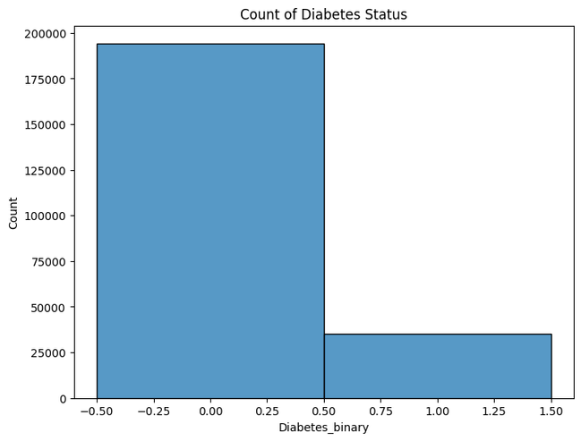
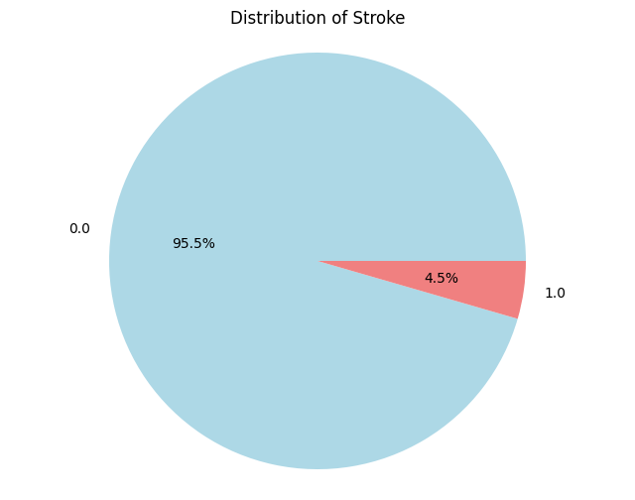
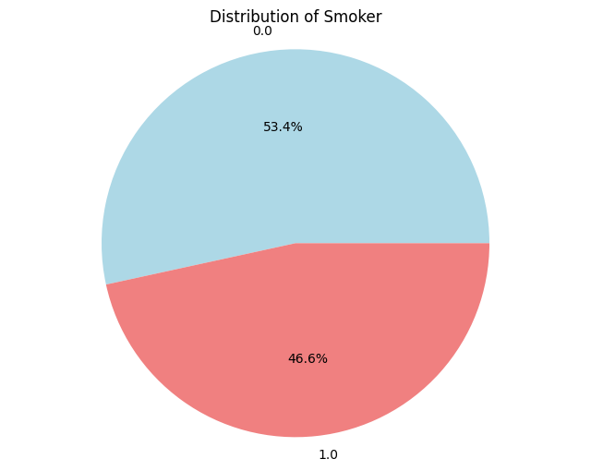
EXPLORATORY DATA ANALYSIS (EDA):
Imbalanced Dataset
The left bar ( representing a Diabetes_binary value of 0) is significantly taller than the right bar (representing a Diabetes_binary value of 1), indicating that the number of non-diabetic cases far outweighs the diabetic cases in your dataset.
This class imbalance can affect the performance of our machine learning models, as they may tend to predict the majority class (non-diabetic) more often.
Approximately 46.6% of the individuals in our dataset are smokers. This near even split provides a good basis for analyzing the impact of smoking on diabetes within our model.
A small percentage (4.5%) of the dataset reported having a stroke. This is a critical medical event that can have a strong relationship with diabetes.

Slide 10
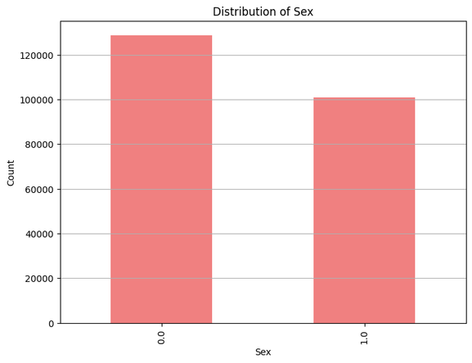
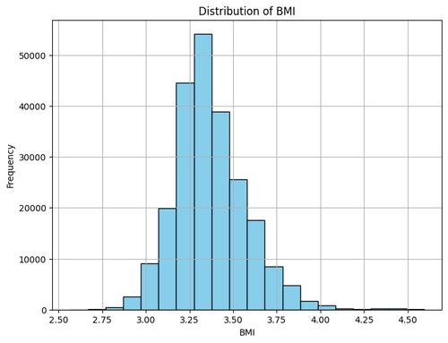
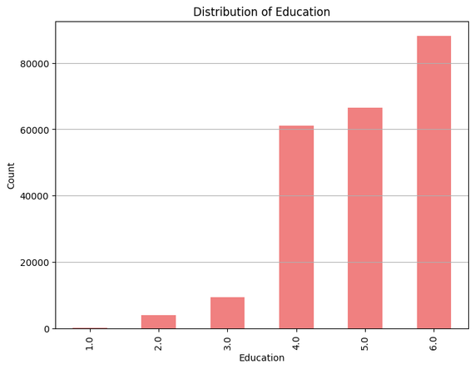
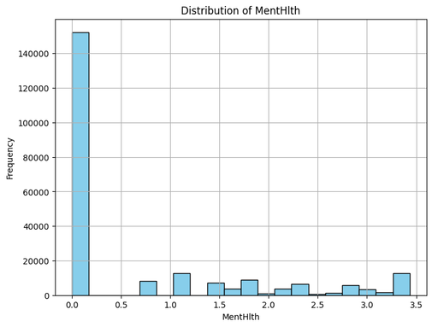
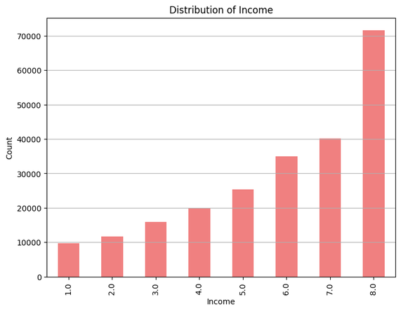
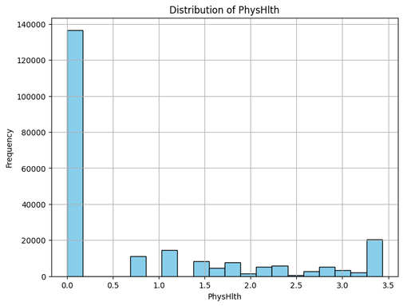
EXPLORATORY DATA ANALYSIS (EDA):
While sex has a relatively small correlation with diabetes incidence in our data, it might still play an important role when interacting with other variables.
Education and income are negatively correlated with diabetes, indicating that as these increase, the likelihood of diabetes decreases. This trend is something our model should capture.
BMI: Given the distribution, BMI is likely an important feature for predicting diabetes, aligning with medical understanding that higher BMI can be a risk factor for diabetes.
Mental Health and Physical Health: While there are fewer people reporting many days of poor health, these variables could still be important for our model. Chronic health issues captured by these variables may significantly impact the risk of diabetes.

Slide 11

FEATURES AND TARGET
Target Variable (y): Diabetes_binary: This is our target variable, as it indicates the presence (1) or absence (0) of diabetes.
Predictor Variables (X):
1. Age and Sex, as these are fundamental demographic variables.
2. BMI: Given its distribution and its known relationship with diabetes.
3. Smoking Status (Smoker): Nearly half of the dataset consists of smokers, and smoking is a risk factor for diabetes.
4. Stroke History (Stroke): While it affects a small percentage of the population, the medical severity of a stroke makes it a potentially strong predictor.
5. High Blood Pressure (HighBP): HighBP is a known risk factor for diabetes and is well-represented across education levels in your dataset.
6. General Health (GenHlth): As the variable with the highest positive correlation to Diabetes_binary, it's a key indicator of overall health.
7. Education Level (Education): Despite the similar prevalence of HighBP across education levels, the overall negative correlation with diabetes suggests it may influence diabetes risk.
8. Income Level (Income): It has a significant negative correlation with diabetes incidence, indicating socioeconomic factors might play a role in diabetes risk.
9. Physical Activity (PhysActivity): With a significant negative correlation, this indicates that more active individuals have a lower risk of diabetes.

Slide 12

ML ALGORITHM
Decision Tree Classifier
Random Forest Classifier
LogisticRegression
XGBoost Classifier
Notes:
Given our imbalanced dataset and the selected features, here are four classification models that can be considered alongside
a decision tree for our diabetes prediction task:
* Decision Tree Classifier: This model is easy to interpret and can handle both numerical and categorical data.
It's a good starting point to understand the basic relationships in your data.
* Random Forest Classifier: An ensemble model that uses multiple decision trees and averages their predictions. Random Forest is
less likely to overfit than a single decision tree and can handle the imbalanced dataset by constructing a more robust
decision boundary.
* Gradient Boosting Machines (GBM): Another ensemble technique that builds trees sequentially with each tree trying to correct
the mistakes of the previous ones. GBMs often perform very well on imbalanced datasets and can provide feature importance scores,
which could be insightful for your analysis.
* Logistic Regression with Class Weight Adjustment: Logistic regression is a simple yet effective model for binary
classification tasks. By adjusting the class weight parameter, you can compensate for the imbalance in the dataset.

Slide 13
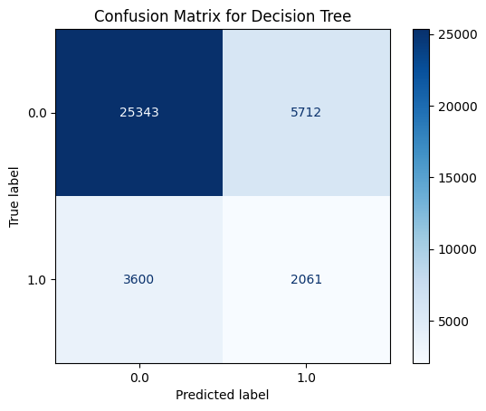
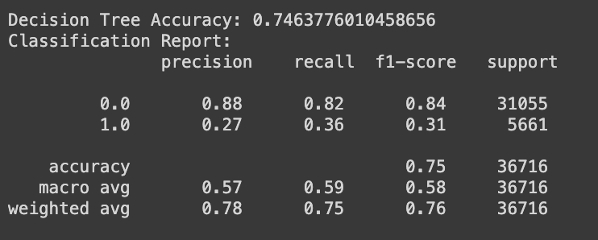
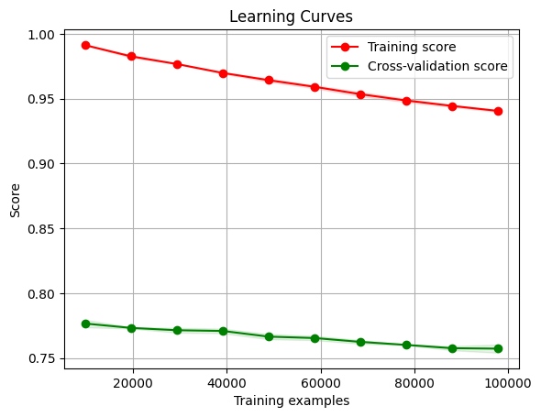

DECISION TREE CLASSIFIER
The model's overall accuracy is skewed by the class imbalance.
there is a significant gap between the training score and the cross-validation score, suggesting that the model might be overfitting to the training data.

Slide 14
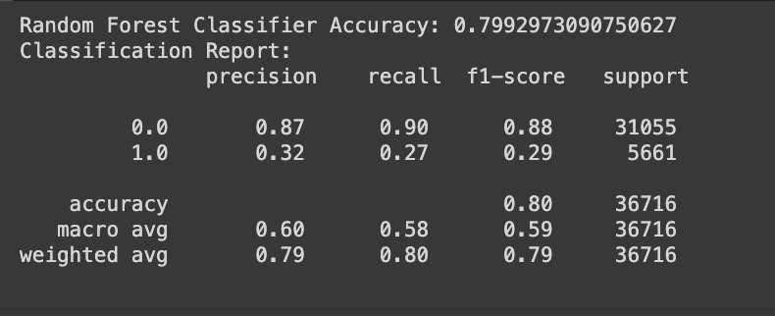

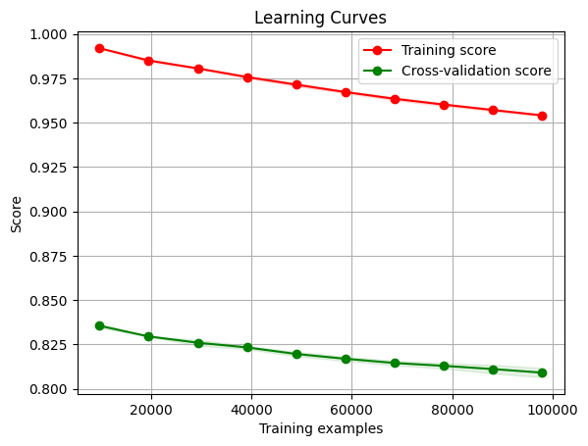
RANDOM FOREST CLASSIFIER
The Random Forest model performs better than the Decision Tree model, with higher accuracy and a better balance between precision and recall for the negative class.
However, similar to the Decision Tree model, it struggles with predicting the positive class (diabetes), which is a significant concern.
The smaller gap between training and validation scores compared to the Decision Tree model suggests better generalization, but there's still room for improvement.

Slide 15
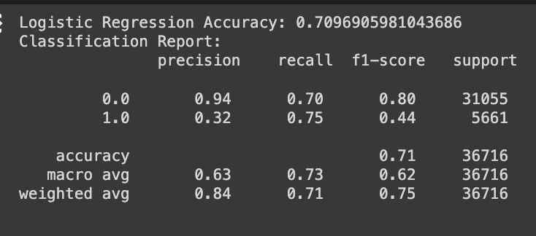
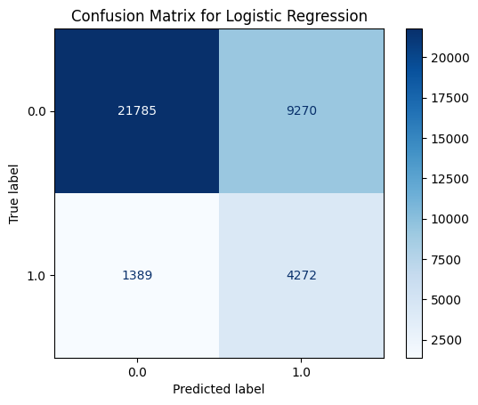
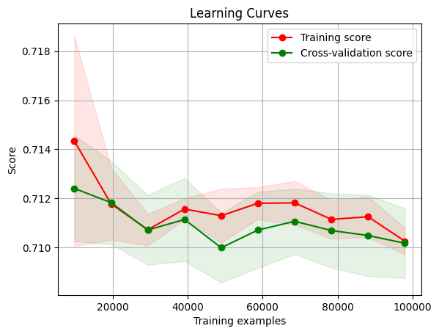
LOGISTIC REGRESSION
The learning curves for Logistic Regression are quite close together, which typically suggests that the model is not overfitting and has a good generalization to unseen data.
Both the training and cross-validation scores are relatively low, indicating that the model may be underfitting or that the dataset is challenging to model with a linear approach.
The model seems to be more biased towards predicting the positive class compared to the Decision Tree and Random Forest models.

Slide 16
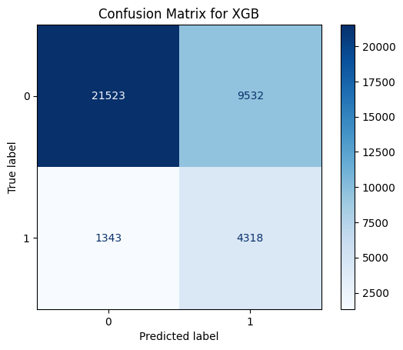
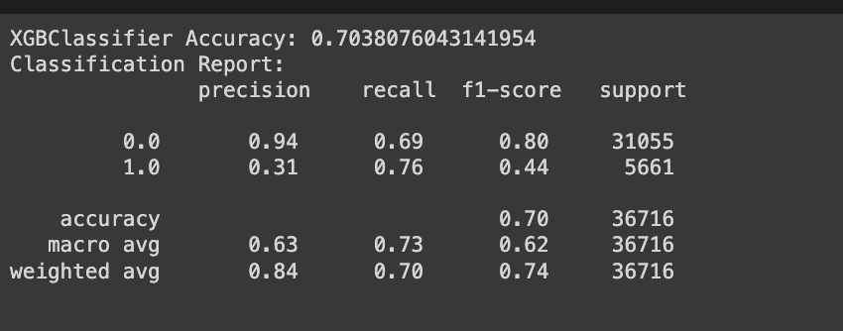
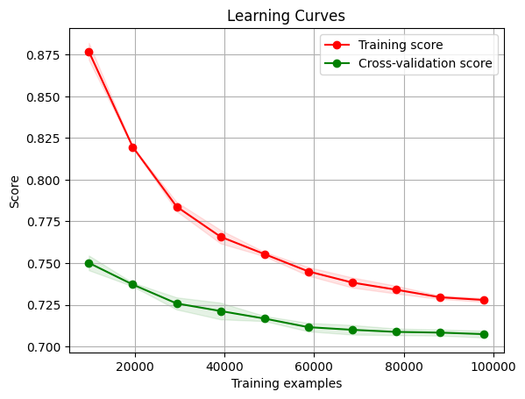

XGB CLASSIFIER
The XGBoost model is doing a good job in terms of recall for the positive class.
However, like the Logistic Regression model, it suffers from a high number of false positives, as indicated by the lower precision for class 1.

Slide 17

Decision Tree Classifier:
Accuracy: 74.64%
The decision tree has a decent recall for the negative class but struggles with precision and recall for the positive class, which shows potential issues with overfitting or underfitting.
Random Forest Classifier:
Accuracy: 79.93%
As an ensemble of decision trees, the Random Forest performs better overall compared to a single Decision Tree, particularly in accuracy and the balance between precision and recall.
Gradient Boosting Classifier and Logistic Regression:
Accuracy: Around 70-71%
These models show high recall for the positive class but significantly lower precision, suggesting they are better at identifying true positives but at the cost of increased false positives.

Slide 18

OPTIMIZER
We have used SGD with logistic regression
Decision Trees & Random Forest models do not use gradient descent in their traditional forms because they are based on entropy or gini impurity calculations for splitting nodes, not on error gradient minimization.
So we can use an ensemble method that uses gradient descent, like Gradient Boosting Trees (another form of boosting different from XGB) which could potentially yield better performance for optimization.

Slide 19
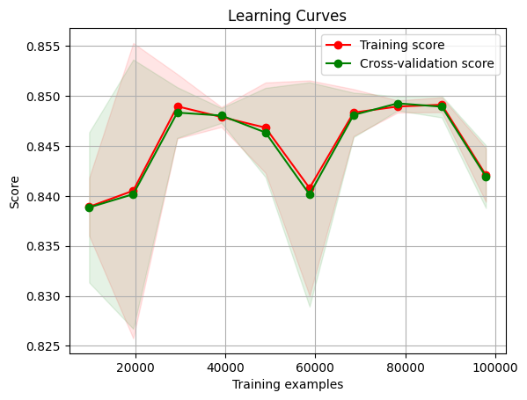
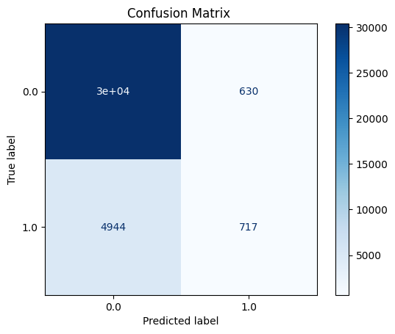
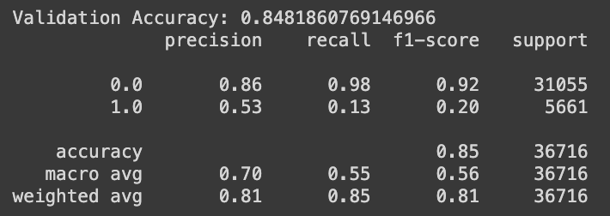
SGD with logistic regression
The learning curves for the SGDClassifier are quite stable, with the training and cross-validation scores being close to each other throughout the range of training examples.
The scores are moderately high, which suggests a decent fit to the data without major overfitting or underfitting issues.
The SGDClassifier performs very well for the negative class but not as well for the positive class, particularly in terms of recall.

Slide 20

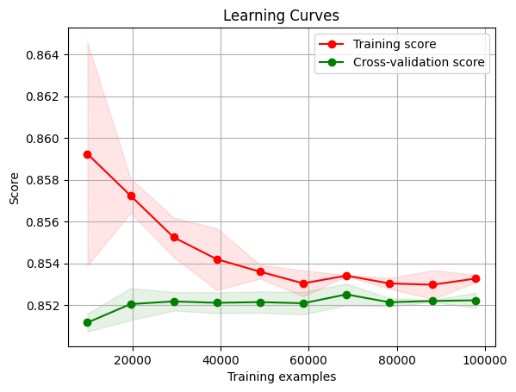
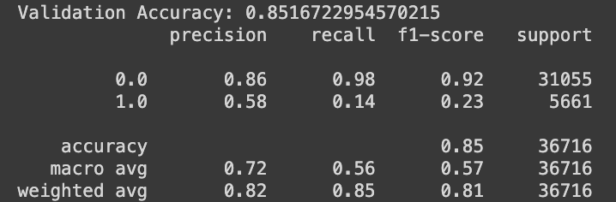
Gradient Boosting Trees
The learning curves show that the training and cross-validation scores are close together, which usually indicates good generalization.
Given the importance of not missing true positive cases in medical diagnoses, the low recall for the diabetes class is a significant concern.

Slide 21
HYPERPARAMETER TUNING
Hyperparameter tuning is crucial for optimizing machine learning models to achieve the best performance. For tuning a Gradient Boosting model, you can use both Grid Search and Random Search, similar to how you would for other models.
Important Hyperparameters for Gradient Boosting
n_estimators: Number of boosting stages to perform. More stages can lead to a better model but also to overfitting.
learning_rate: Controls the contribution of each tree. There is a trade-off between learning rate and number of trees.
max_depth: Maximum depth of the individual regression estimators. Controls the complexity of the model.

Slide 22

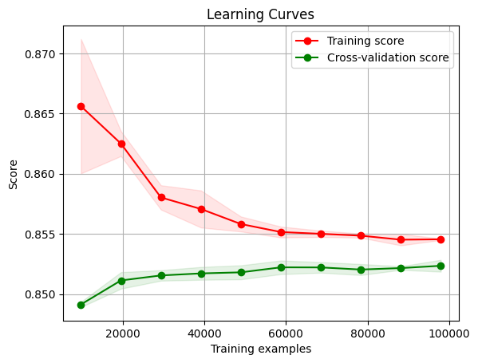
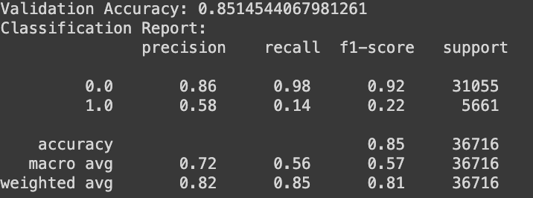
HYPERPARAMETER TUNING
Best Parameters: The optimal parameters found through the grid search are learning rate = 0.1 , max depth = 3 , estimators = 300.
The learning curves shows a consistent generalization performance, with a small gap between the training and cross-validation scores. This indicates that the model is not overfitting
The slight decline in the training score with more training examples suggests that the model's complexity is sufficient to handle more complex patterns in the data.
The validation results from our Gradient Boosting model after hyperparameter tuning show some improvements in specific areas but also highlight continuing challenges, particularly with the recall for the positive class (1.0).

Slide 23
SMOTE
To apply SMOTE to our dataset and then retrain our Gradient Boosting model using the best parameters obtained from the grid search
We need to apply SMOTE to the training data to balance it.
*Retrain the Gradient Boosting model using the balanced training data
Evaluate the model on the original, unmodified validation set.

Slide 24
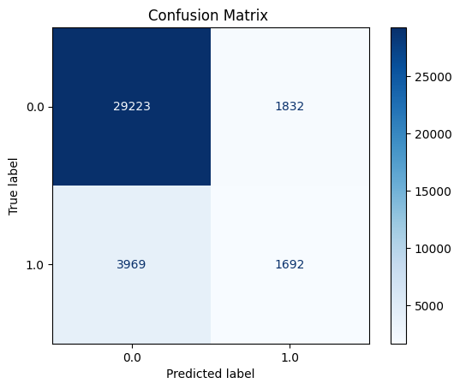

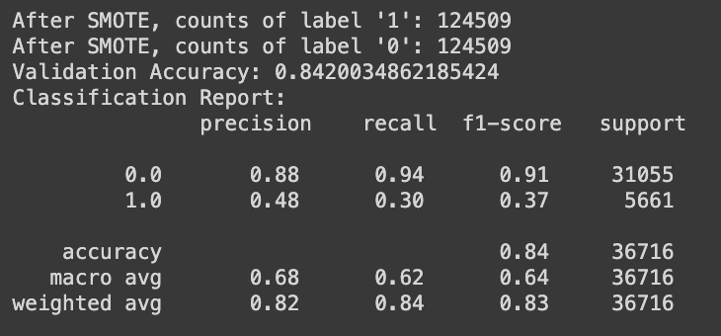
Both classes now have 124,509 instances, which should give the model a fair chance to learn from both classes equally.
Accuracy: 84.15% - This is slightly lower than the previous accuracy before SMOTE, which is expected as the model now has to deal with a more complex pattern after balancing the classes.
Precision & recall : The model's performance has improved for the minority class. The increase in recall for class 1 means the model is now identifying more true cases of diabetes.
F1-Score This score indicates a good balance of precision and recall for the negative class and the positive class after applying SMOTE.
The learning curves remain close between training and validation, which suggests that the model generalizes well even after addressing class imbalance.

Slide 25

COMPARISION
Logistic Regression showed moderate accuracy and high recall for the positive class but has low precision, indicating a high number of false positives.
Random Forest: Showed good accuracy and was effective in generalizing but had poor recall for the positive class, suggesting it struggled with the minority class.
Gradient Boosting: Achieved high accuracy and the best balance between precision and recall among the models, especially after applying techniques like SMOTE.
XGBoost: Similar to Gradient Boosting in terms of accuracy and precision/recall balance but slightly underperformed compared to the tuned Gradient Boosting model.

Slide 26
IMPROVEMENTS
Adjusting the decision threshold might help increase recall further or balance the precision-recall trade-off for the minority class.
Enhancing the feature set or introducing new features could help the model make better distinctions between classes.
Using methods like stacking or blending multiple models could improve prediction accuracy and balance.
Using more than 3 folds might provide a more robust estimate of the model's performance and its variability across different subsets of the data.

Slide 27

CONCLUSION
Gradient Boosting is the selected algorithm for several reasons:
It offered the highest accuracy and an improved recall for the positive class without excessively sacrificing precision, especially after applying SMOTE.
Gradient Boosting demonstrated a significant improvement in handling class imbalance with the aid of SMOTE.
Although it is a complex model compared to Logistic Regression, its performance gains justify the increased complexity. Moreover, the ability to tune its parameters provided a way to manage overfitting and underfitting effectively.

Slide 28

Thank you

